Slide 1

Automotive Technology: A Systems Approach, 8e
Chapter 42: Electronic Automatic Transmissions
Rob Thompson and Jack Erjavec, Automotive Technology: A Systems Approach, 8th Edition. © 2025 Cengage. All Rights Reserved. May not be scanned, copied or duplicated, or posted to a publicly accessible website, in whole or in part.

Slide 2
Chapter Objectives (1 of 2)
42.01 Describe the components used for electronic transmission operation.
42.02 Explain hybrid transmission operation.
42-03 Conduct preliminary checks on the EAT systems and determine needed repairs or service.

Slide 3
Chapter Objectives (2 of 2)
42.04 Perform converter clutch system tests and determine needed repairs or service.
42.05 Inspect, test, and replace electrical/electronic sensors.
42.06 Inspect, test, and replace actuators.

Slide 4
Electronic Automatic Transmissions (EATs)
42.01 Describe the components used for electronic transmission operation.
Electronic transmission control provides better shift timing, shift quality, improved fuel economy, and reduced emissions.
A control module activates solenoids that control fluid pressure to the clutches and bands.

Slide 5
Transmission Control Module
Controls shift timing, shift feel, and the torque converter clutch.
Uses input from engine- and driver-related sensors.
Shift decisions are based on shift schedules and logic.

Slide 6
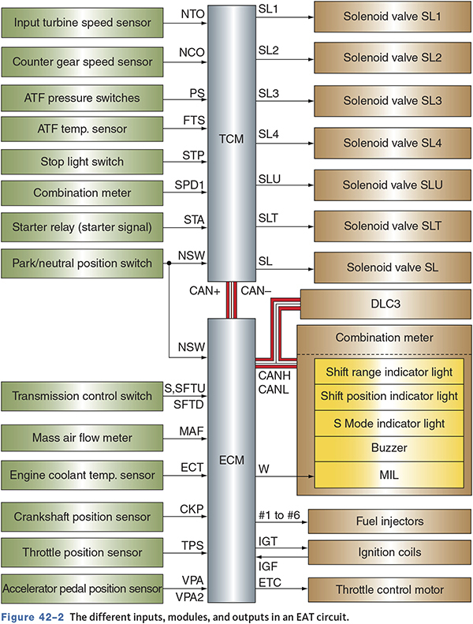
Different Inputs, Modules, and Outputs in an EAT circuit

Slide 7
Inputs
May be directly from a sensor or via the CAN system
Typical inputs for the transmission control module (TCM)
  TP sensor
  MAF sensor
  BARO sensor
  CKP sensor
  MAP sensor
  IAT sensor
  ECT sensor

Slide 8
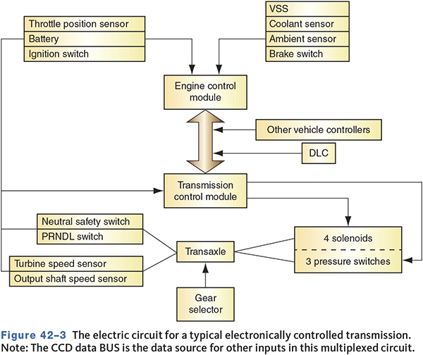
Typical Electronically Controlled Transmission

Slide 9
On-Off Switches
Brake pedal position switch.
    Turns off the TCC.
Transmission control switch.
    Turns off overdrive.
A/C request switch.
    Adapts for increased load on the engine.
Cruise control switch.
    Softens shift patterns.

Slide 10
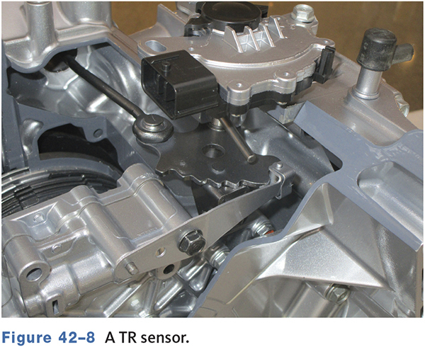
Digital Transmission Range (TR) Sensor
All shift schedules based on gear selected.
May also contain neutral safety and reverse light switch.

Slide 11
Throttle Position (TP) Sensor
Informs TCM of driver intent.
Used in place of hydraulic throttle pressure linkage.
Important for shift scheduling, electronic pressure control, and TCC control.
Low TP voltage will cause early upshifts.

Slide 12
Mass Air Flow (MAF) Sensor
Used to calculate engine load.
Regulates
    Electronic pressure control (EPC)
    Shift scheduling
    TCC control

Slide 13
Temperature Sensors (1 of 2)
Shift schedules influenced by engine temperature.
May delay shifts to increase engine temperature.
High engine temperatures may cause earlier shifts or TCC in second or third gear.

Slide 14
Temperature Sensors (2 of 2)
Temperature Range | Gear Operation | TCC Operation
Below –16 °F (–27 °C) | Operates only in Park, Neutral, Reverse, 1st, and 3rd gears | NO
Between –12 °F (–24 °C) and 10 °F (–12 °C) | Upshifts from 2nd to 3rd and 3rd to 4th are delayed and downshifts from 4th to 3rd and 3rd to 2nd are early | NO
Between 10 °F (–12 °C) and 36 °F (2 °C) | All shifts are delayed | NO
Between 40 °F (4 °C) and 80 °F (27 °C) | Normal shifting | NO
Between 80 °F (27 °C) and 240 °F (116 °C) | Normal shifting | YES, normal
More than 240 °F (116 °C), or if the engine is overheating | 2nd to 3rd and 3rd to 4th shifts are delayed | YES, but longer
Above 260 °F (127 °C) | 2nd to 3rd and 3rd to 4th shifts are greatly delayed | YES, nearly full time

Slide 15
Engine Speed
Used to determine shift timing, wide-open throttle (WOT) shift control, TCC control, and EPC pressure.
Also used to prevent the engine from running at too high an RPM by commanding an upshift.

Slide 16
Transmission Pressure Switches
Keeps the TCM informed as to which hydraulic circuits are pressurized.
May serve as verification to other inputs.
Most common is a transmission fluid pressure switch.
    Monitors when a clutch or band is applied or released.

Slide 17
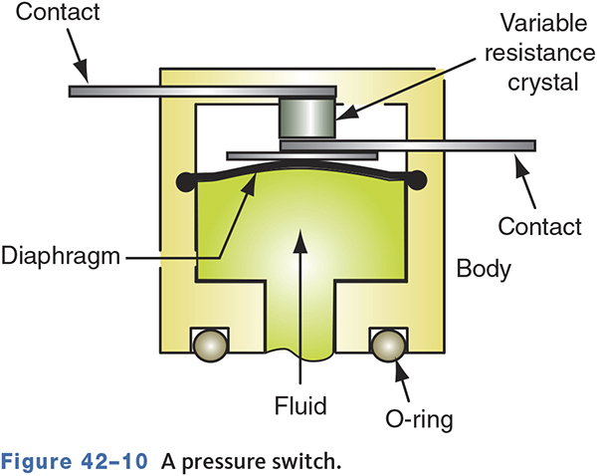
Transmission Pressure Switches

Slide 18
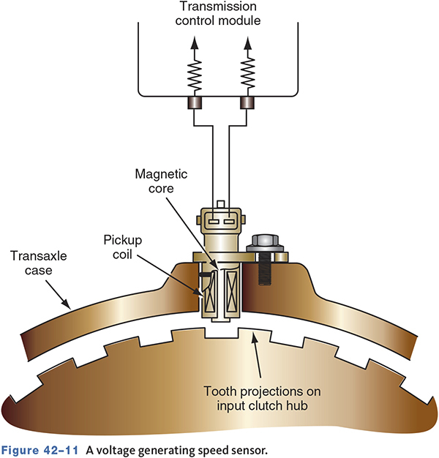
Voltage-Generating Sensors
Used as governor signal.
VSS signal used for shift timing.
Some transmissions use output shaft speed (OSS) sensors and input shaft speed (ISS) or turbine speed (TSS) sensors.
Used to determine TCC slip.

Slide 19
Knowledge Check (1 of 2)
Technician A says that a Hall-effect sensor is used as a speed sensor.
Technician B says a PM generating sensor is used as a speed sensor.
Who is Correct?

Slide 20
Knowledge Check Answer (1 of 2)
Technician A says that a Hall-effect sensor is used as a speed sensor.
Technician B says a PM generating sensor is used as a speed sensor.
Who is Correct?
Answer: Both Technician A and B

Slide 21
Outputs
Common outputs are indicator lamps and solenoids.
Some vehicles have a transmission MIL.

Slide 22
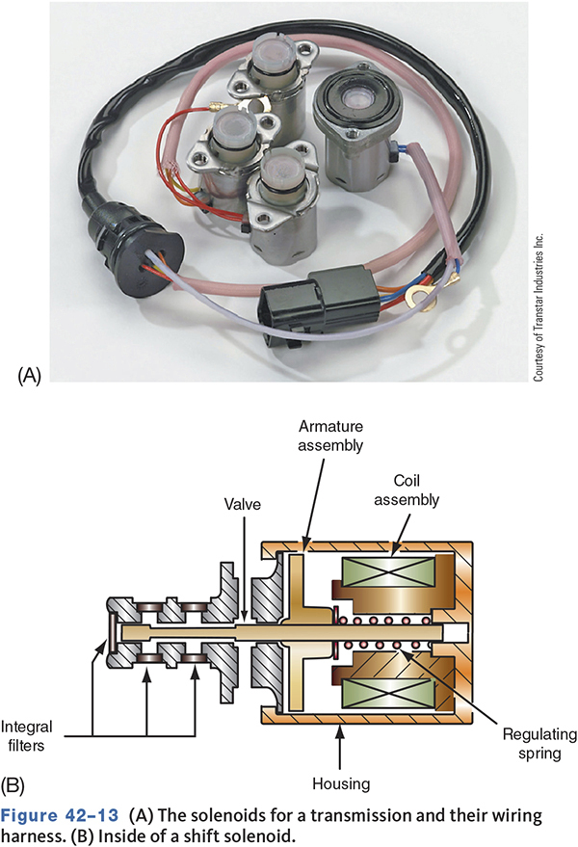
Shift Solenoids
Regulate shift timing and feel.
Controls the delivery of fluid.
Solenoids are normally on/off and are off in the open position.
A four-speed transmission typically has two shift solenoids.

Slide 23
Pressure Control Solenoids
Replaces the throttle valve cable.
Controls hydraulic pressure to clutches.
Usually called the electronic pressure control (EPC) solenoid.
Most are variable force or pulse width modulated.

Slide 24
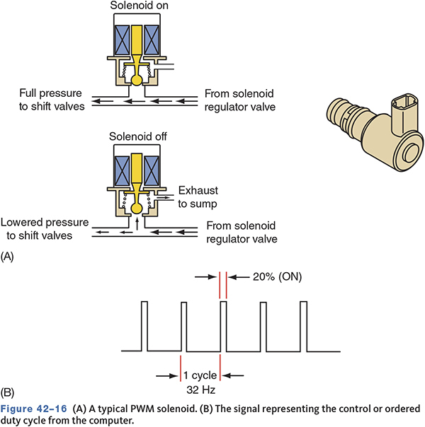
A) Typical PWM Solenoid B) Control or Ordered Duty Cycle

Slide 25
TCC Solenoid
Controls the application, modulation, and release of the TCC.
When the solenoid is off, fluid is exhausted and the clutch is released.
Modulating the pressure allows for smooth engagement and disengagement.

Slide 26
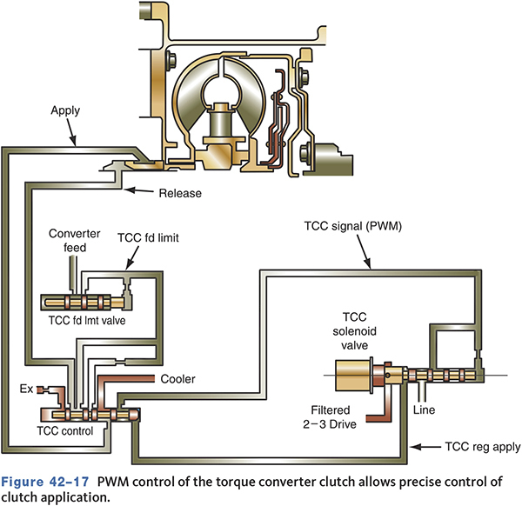
PWM Control

Slide 27
Adaptive Controls
Adaptive learning allows for changes based on conditions and driver habits.
Line pressure control compensates for normal wear.
May compensate for changes in the engine’s performance.

Slide 28
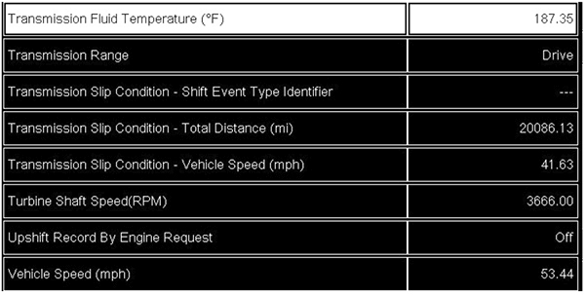
Transmission Adaptive Data

Slide 29
Limp-In Mode
Also called fail-safe or default mode.
Allows for limited driving ability.
Designed to prevent further damage.
May lock the transmission in a particular gear or only allow park, neutral, reverse, and two gears.

Slide 30
Operational Modes
Many transmissions have two selective modes—normal and power.
Normal mode operates according to shift schedules for normal operation.
Power mode allows for better acceleration and performance.
Auto mode may combine normal with power mode if the throttle is opened quickly.

Slide 31
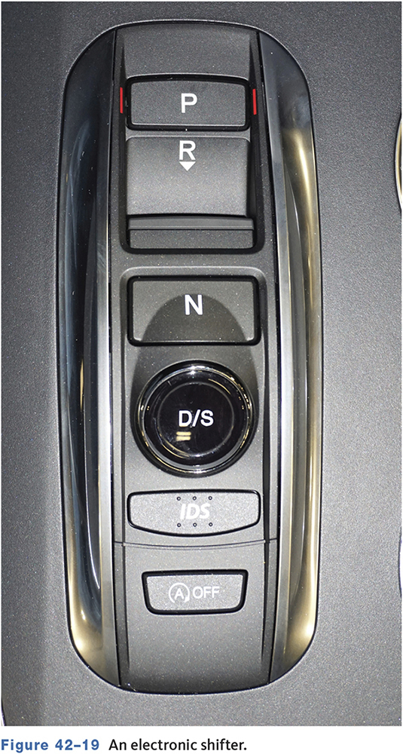
Manual Shifting
Allows the driver to manually shift without a clutch.
The driver moves the gear selector or a button to change gears.
Still an automatic transmission.

Slide 32
Knowledge Check (2 of 2)
Technician A says that a mass air flow sensor is a thermistor.
Technician B says a speed sensor may be a voltage generating sensor.
Who is correct?

Slide 33
Knowledge Check Answer (2 of 2)
Technician A says that a Mass air flow sensor is a thermistor.
Technician B says a speed sensor may be a voltage generating sensor.
Who is correct?
Answer: Technician B only

Slide 34
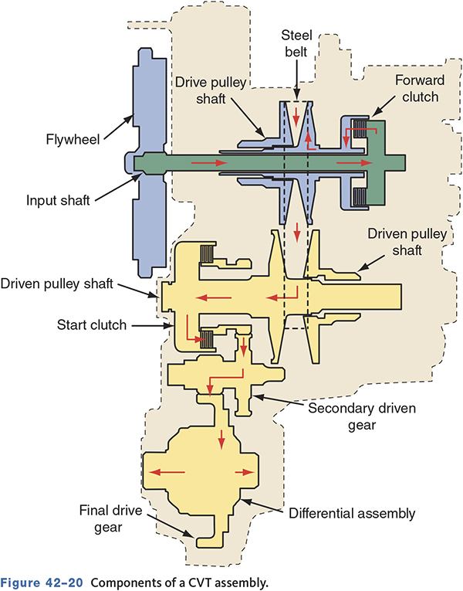
CVT Controls
Pulley ratios are controlled by the TCM.
The start clutch is designed to slip just enough to get the vehicle moving.
Pulley ratios are changed to reduce engine speed and maintain ideal engine temperatures.

Slide 35
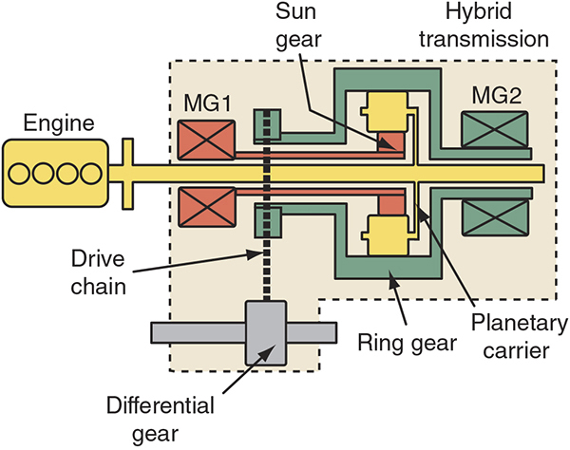
Hybrid Transmissions (1 of 2)
42.02 Explain hybrid transmission operation.
May be fitted with electric motors to propel the vehicle and provide a constantly variable ratio.

Slide 36
Hybrid Transmissions (2 of 2)
Honda—uses a modified 5-speed or CVT.
Toyota—power-split device acts as a CVT.
4WD—may use an electric rear drive unit.
Ford—electronically controlled CVTs.
GM Two-mode—uses three planetary gearsets and two electric motors.

Slide 37
Basic EAT Testing
42.03 Conduct preliminary checks on the EAT systems and determine needed repairs or service.
Determine if problem is with the transmission or the electronics.
Perform preliminary inspection and checks.
Connect a scan tool to check for codes.
Manually activate solenoids.
Remember engine problems can and will cause the transmission to act abnormally.

Slide 38
Scan Tool Checks
Observe the MIL.
Retrieve DTCs.
Monitor serial data.
Compare observed data to manufacturer’s specifications.

Slide 39
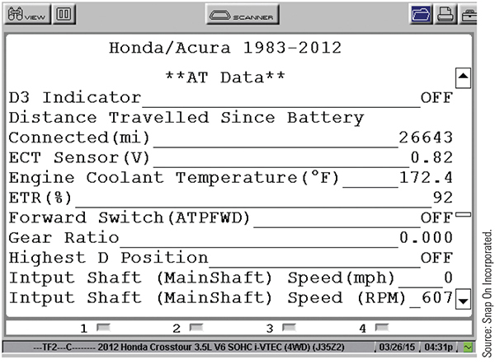
Engine-Related Scan Tool Data

Slide 40
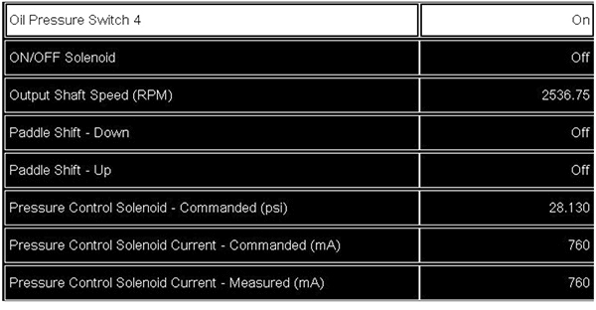
Transmission Specific Data

Slide 41
Preliminary EAT Checks
Road test with scan tool.
Monitor gear changes and inputs such as:
  Engine speed
  Vehicle speed
  Manifold vacuum
  Operating gear
  Time required to shift gears

Slide 42
Electronic Defaults
Refer to the service manual for default operation information.
May go into default or limp-in mode if a problem that may increase wear or cause damage is detected.

Slide 43
Guidelines for Diagnosing EATs (1 of 2)
Battery must have least 12.6 volts.
Check all fuses.
Check all sensors and wiring.
Use a high impedance test light or DMM.
Check power, ground, and signal return wiring.
Check solenoids before computer replacement.
Check computer harness routings.

Slide 44
Guidelines for Diagnosing EATs (2 of 2)
Guard against static discharges.
Check voltage drop of ground circuits.
Ignition off when making/breaking connections.
Check sensors when hot and cold.
Check wire terminal tightness and condition.

Slide 45
Converter Clutch Control Diagnosis
42.04 Perform converter clutch system tests and determine needed repairs or service.
Understand TCC operation and controls.
TCC engagement can be monitored with a pressure gauge while test driving.
  Engagement should feel smooth.
Shudder or vibration may indicate TCC not applied with full pressure, applied early, out-of-round converter, or contaminated fluid.

Slide 46
Detailed Testing of Inputs (1 of 2)
42.05 Inspect, test, and replace electrical/electronic sensors.
Switches
  Can be checked with an ohmmeter or test light.
  Pressure switches can be air pressure checked.
TP Sensor
  Can be checked with an ohmmeter or voltmeter.
  Lab scope will easily show glitches.

Slide 47
Detailed Testing of Inputs (2 of 2)
MAF
  Can be checked with a DMM, scan tool, or scope.
Temperature Sensors
  Check with an ohmmeter.
Speed Sensors
  Can be checked with a DMM, scan tool, or scope.

Slide 48
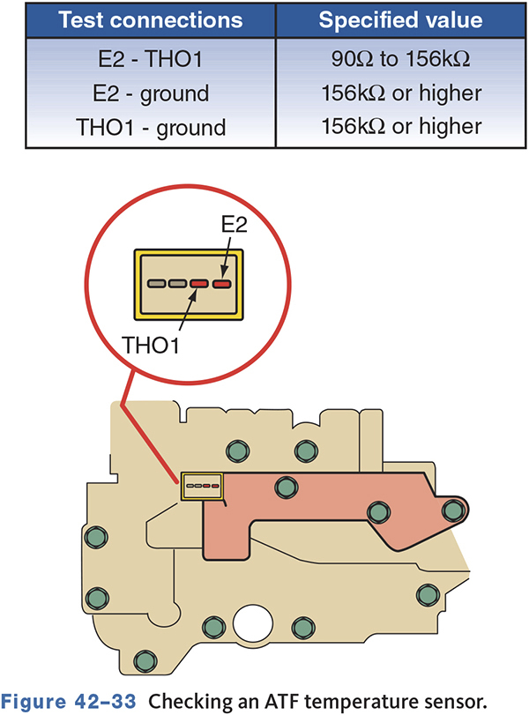
Checking an ATF Temperature Sensor

Slide 49
Detailed Testing of Actuators
42.06 Inspect, test, and replace actuators
Determine if solenoids are case grounded or computer grounded.
Manually activate solenoids with scan tool.
Test under light load, half, and full throttle.
May shift fine under light load but not exhaust enough when pressure increases.

Slide 50
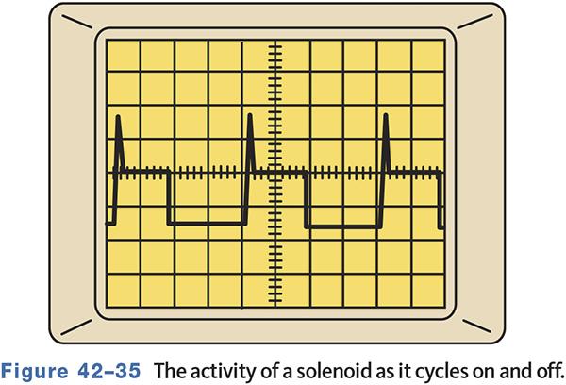
Testing Actuators with a Lab Scope
Testing with a lab scope allows you to watch the electrical activity of the circuit.
Some actuators are pulse-width modulated, some frequency controlled, or by voltage levels.

Slide 51
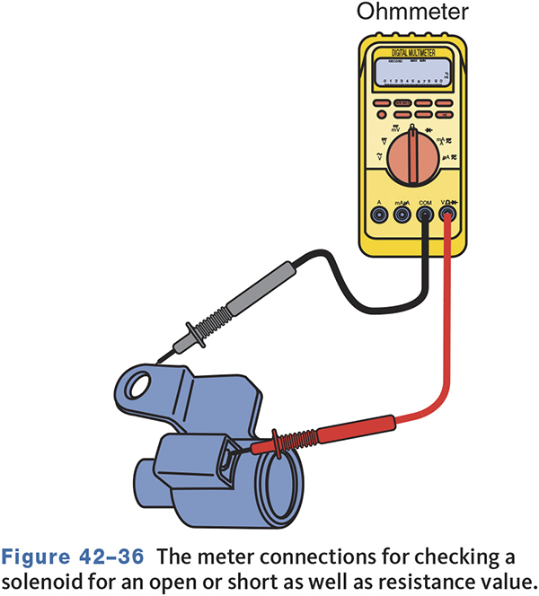
Testing Actuators with an Ohmmeter
Solenoids can be checked for resistance and opens.
The circuit can be tested for shorts to ground and high resistance.

Slide 52
Chapter Reflection
Describe the concept from this chapter that challenged you the most. Describe what made the concept difficult for you and the steps you took to improve your understanding.
How could you help another learner who was struggling with the same concept.
Use 100–150 words in your answer.

